Slide 1
Turning Business Rules into Decision Tables

Slide 2
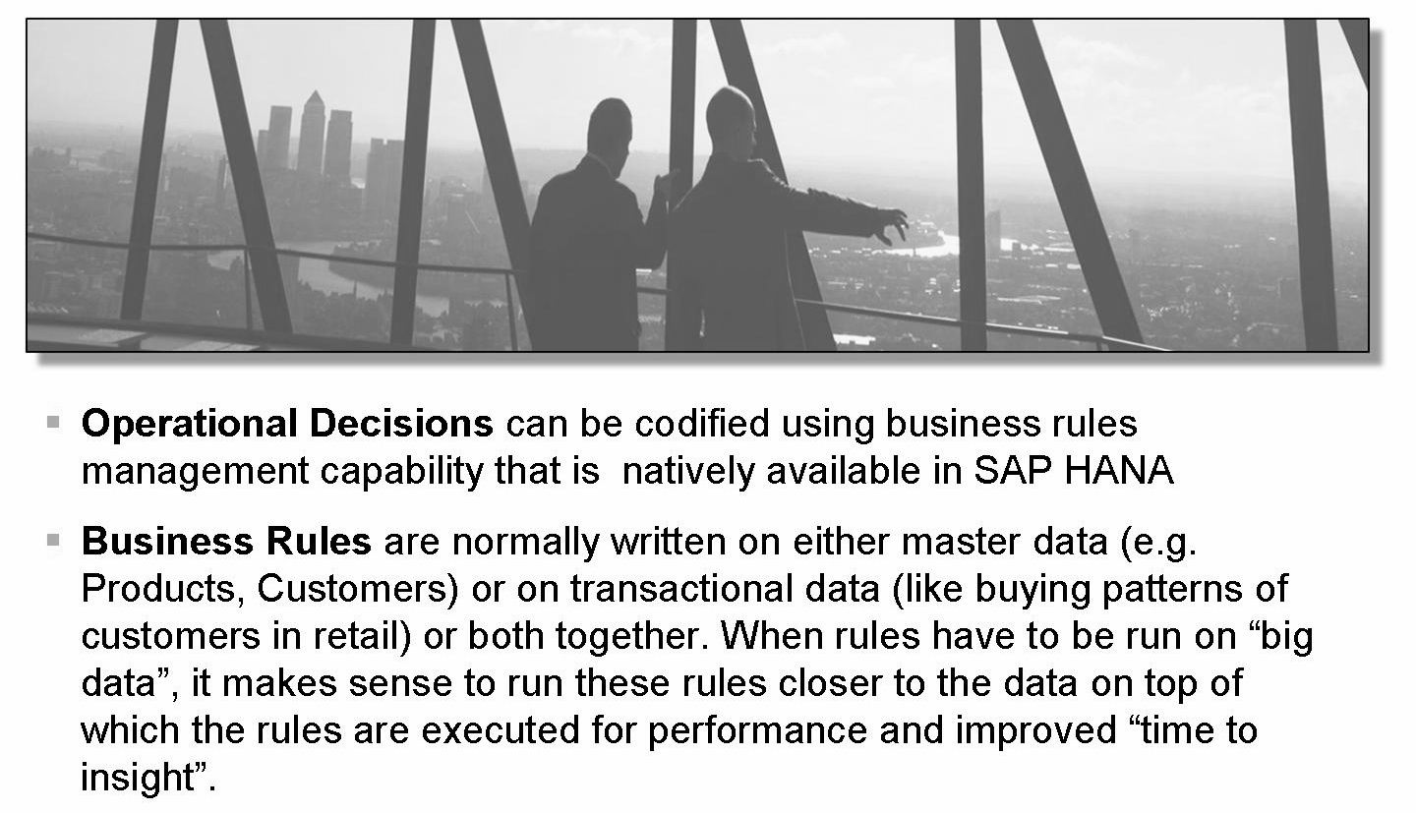
Decision Tables Overview
Decision tables used to manage business rules, data validation, and data quality rules, without needing any knowledge of technical languages such as SQL Script or MDX.

Slide 3
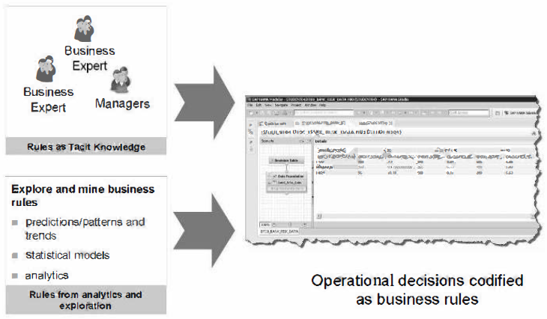

Slide 4
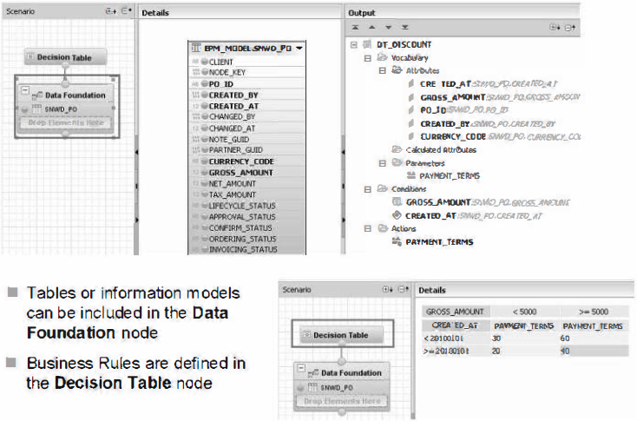

Slide 5
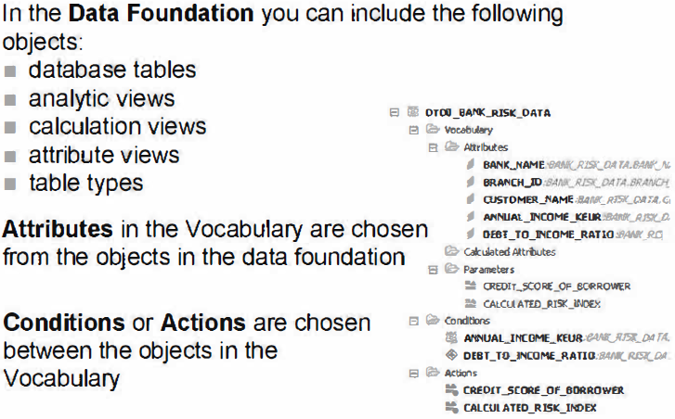

Slide 6
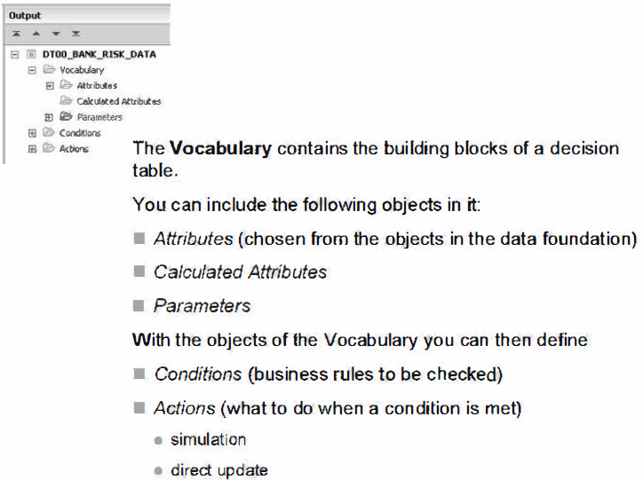
The building blocks of a Decision Table are the Vocabulary, Conditions and Actions.

Slide 7
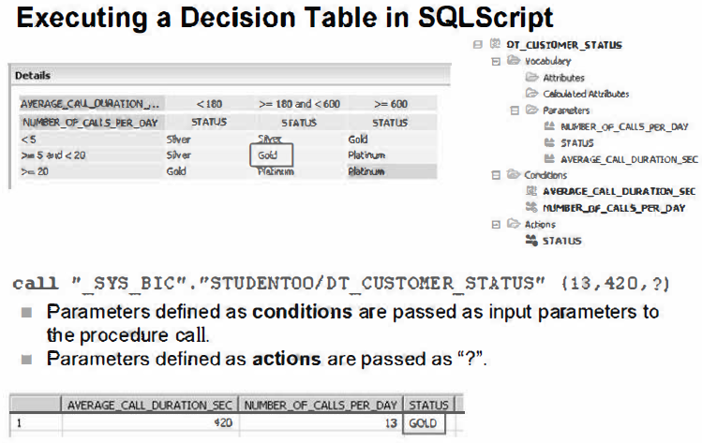
A Decision Table can be modeled for different purposes:
to update a database table, based on the defined business rules
for simulation or analytic purposes
The purpose of the Decision Table must be decided at design time.
Other HANA applications can consume a Decision Table as a SQL Script.

Slide 8
The creation process of a Decision Table
• Create a New Decision Table inside a Package.
• Define the Vocabulary in the Data Foundation node, by optionally including
database or modeling objects in it. Define Conditions and Actions.
• Define your Business Rules in the Decision Table node by typing or uploading
the rules.
• Consume the Decision Table, e.g. directly or inside a calculation view from the
SAP HANA Studio or from a Business Intelligence reporting tool.

Slide 9
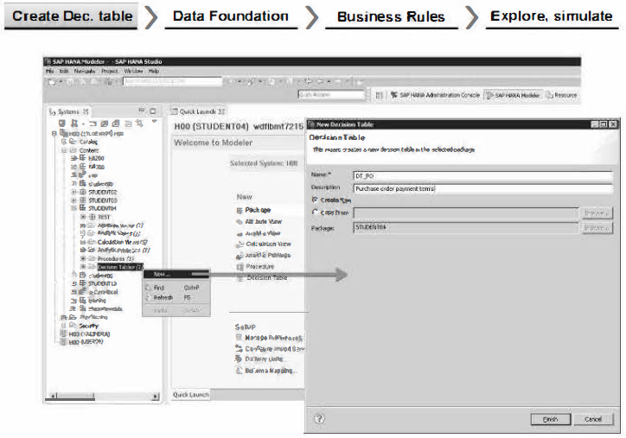

Slide 10
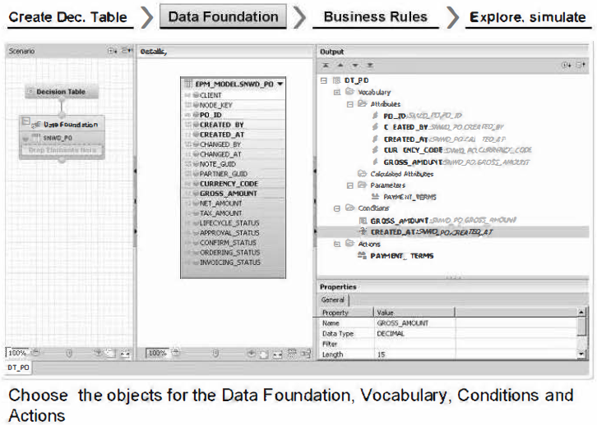

Slide 11
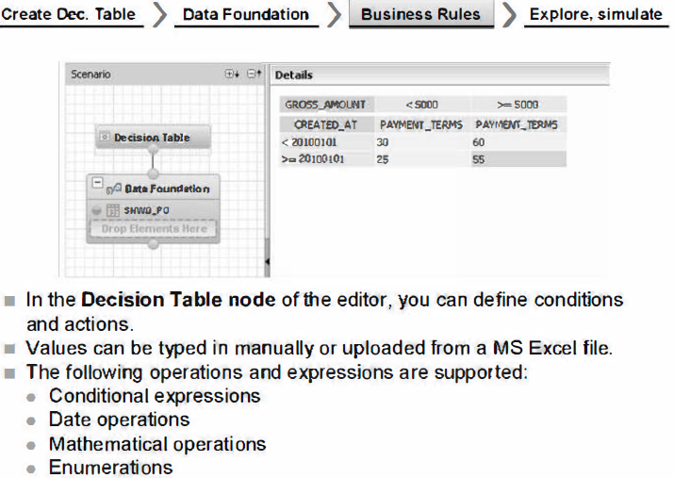

Slide 12
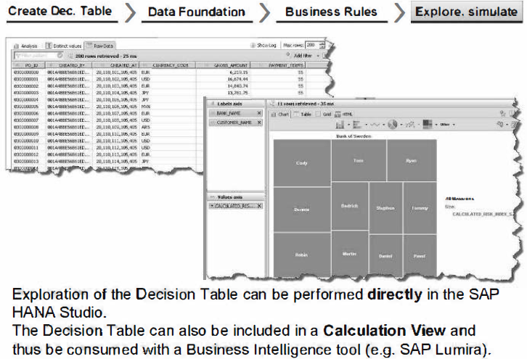

Slide 13
THANK YOU
Courtesy : SAP Labs Document -
HA 300 – SAP HANA Implementation and Modeling

